Slide 1

DIGITAL ELECTRONICS
III Semester CSE, CSE (AIML) & CSE (DS)
Dr. Ajit Kumar Patro
DEPARTMENT OF ELECTRONICS AND COMMUNICATION ENGINEERING
SCHOOL OF ENGINEERING & TECHNOLOGY
GIET UNIVERSITY, GUNUPUR, ODISHA

Slide 2
Representation of Signed Binary Number

Slide 3
1’s Complement
The 1's complement of any binary number is performed by simply changing all 1's into 0's and 0's into 1's, i.e. each bit is replaced by its complement.
Binary number 1's complement
1011 0100
010101 101010
1100.01 0011.10
10010.110 01101.001

Slide 4
2’s Complement
The 2's complement of any binary number is determined by adding 1 to 1's complement of that number.
2's complement of number =
1's complement of a number + 1

Slide 5
Example:
Find the 2's complement of the (1010)₂
Solution
Given binary number = 1010
1's complement of 1010 = 0101
+ 1
0110
2's complement of 1010 = 0110

Slide 6
Example:
Find the 2's complement of the (11.01)₂
Solution
Given binary number = 11.01
1's complement of 11.01 = 00.10
+ 1
00.11
2's complement of 11.01 = 00.11

Slide 7
Binary number: 1010 1111 11.01
2’s complement: 0110 0001 00.11
Note: The 2’s complement of a number can be obtained by leaving all least significant 0’s and the first one (1) unchanged, and replacing all 1’s with 0’s and 0’s with 1’s in all higher significant bits.

Slide 8
REPRESENTATION OF SIGNED NUMBER
There are two ways of representing signed numbers
Sign-magnitude form
Complement form
There are two complement forms:
1's complement form
2's complement form

Slide 9
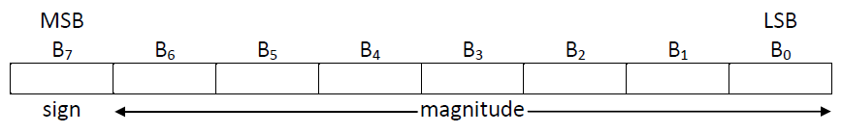
Sign-magnitude Representation
The sign-magnitude format for 8-bit signed number
Here, the most significant bit (MSB) represents sign of the number.
If MSB is 1, number is negative and if MSB is 0, number is positive.
The remaining (seven) bits represent magnitude of the number.

Slide 10
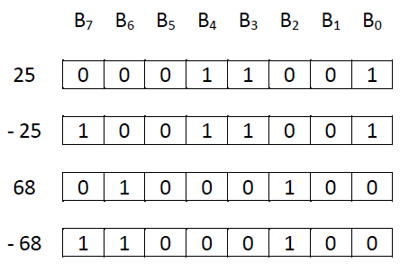
Example: Represent the following signed number in sign-magnitude form.
(a) 25 (b) – 25 (c) 68 (d) - 68

Slide 11
NOTE: The actual range of numbers we can represent in sign-magnitude format for n-bit would be
- (2^{n-1} - 1) to + (2^{n-1} - 1)
Example:
If we have 8 bits to represent a signed binary number, (1-bit for the sign bit and 7-bits for the magnitude bits), then the actual range of numbers we can represent in sign-magnitude format would be:
- (2⁸⁻¹ – 1) to + (2⁸⁻¹ – 1)
- (2⁷ - 1) to + (2⁷ – 1)
- 127 to + 127

Slide 12
1's complement Representation
If the number is positive, the magnitude is represented in its true binary form and a sign bit 0 is placed in front of the MSB.
If the number is negative, the magnitude is represented in its 1’s complement form and a sign bit 1 is placed in front of the MSB.

Slide 13
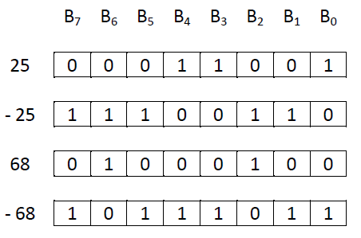
Example: Represent the following signed number in 1’s complement form.
(a) 25 (b) - 25 (c) 68 (d) - 68

Slide 14
2's complement Representation
If the number is positive, the magnitude is represented in its true binary form and a sign bit 0 is placed in front of the MSB.
If the number is negative, the magnitude is represented in its 2’s complement form and a sign bit 1 is placed in front of the MSB.

Slide 15
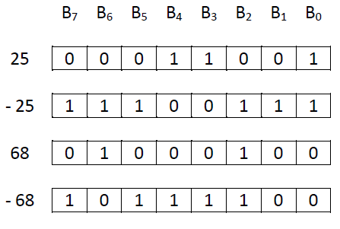
Example: Represent the following signed number in 2’s complement form.
(a) 25 (b) - 25 (c) 68 (d) - 68

Slide 16
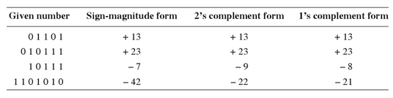
Example: Each of the following numbers is a signed binary number. Determine the decimal value in each case, if they are in (i) sign-magnitude form, (ii) 2's complement form, and (iii) 1's complement form.
(a) 01101 (b) 010111 (c) 10111 (d) 1101010
Solution:

Slide 17
Binary Arithmetic's

Slide 18
1. Binary Addition
The rules of binary addition are the following:
  0 + 0 = 0
  0 + 1 = 1
  1 + 0 = 1
  1 + 1 = 10, i.e. 0 with a carry of 1

Slide 19
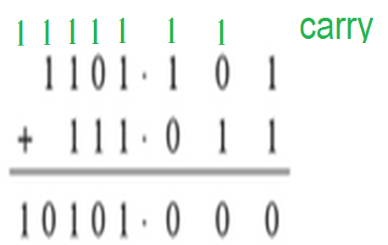
Example: Add the binary numbers 1101.101 and 111.011
Solution

Slide 20
2. Binary Subtraction
The rules of binary subtraction are the following:
  0 - 0 = 0
  0 - 1 = 1, with a borrow of 1
  1 - 0 = 1
  1 - 1 = 0

Slide 21
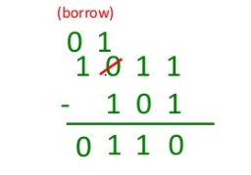
Example: Subtract the binary number 101 from 1011
Solution

Slide 22
3. Binary Multiplication
The rules of binary multiplication are the following:
  0 × 0 = 0
  0 × 1 = 0
  1 × 0 = 0
  1 × 1 = 1

Slide 23

Example: Multiply the binary number 1101 by 110
Solution

Slide 24
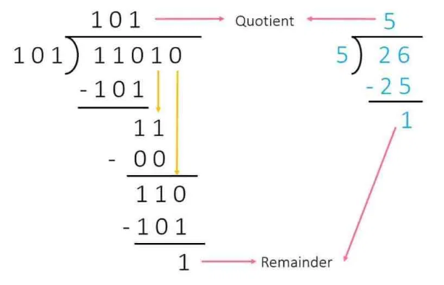
4. Binary Division
Example: Divide the binary number 11010 by 101
Solution

Slide 25
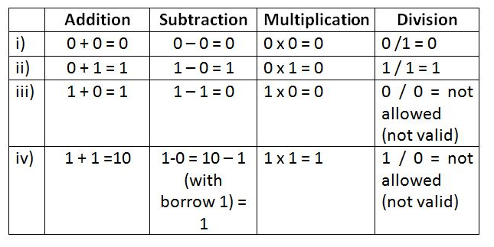
Rules of Binary Arithmetic

Slide 26
Binary Arithmetic using 1’s and 2’s Complements

Slide 27
Logic for Binary Arithmetic
The binary arithmetic operation can be written as:
A + B = A + B
A – B = A + (-B)
- A + B = (-A) + B
- A – B = (-A) + (-B)
The negative binary number can be represented either 1’s or 2’s complement form.

Slide 28
Binary Arithmetic using 1’s Complements

Slide 29
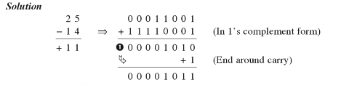
Example-1: Subtract 14 from 25 using 1’s complement method.

Slide 30

Example-2: Add -25 to 14 using 1’s complement method.

Slide 31
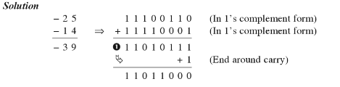
Example-3: Add -14 to -25 using 1’s complement method.

Slide 32

Example-4: Add 14 to 25 using 1’s complement method.

Slide 33
Binary Arithmetic using 2’s Complements

Slide 34
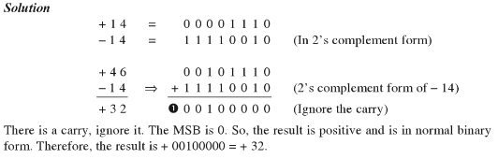
Example-1: Subtract 14 from 46 using 2’s complement method.

Slide 35
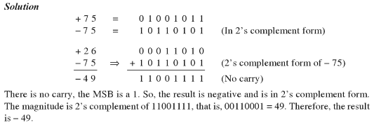
Example-2: Add -75 to 26 using 2’s complement method.

Slide 36
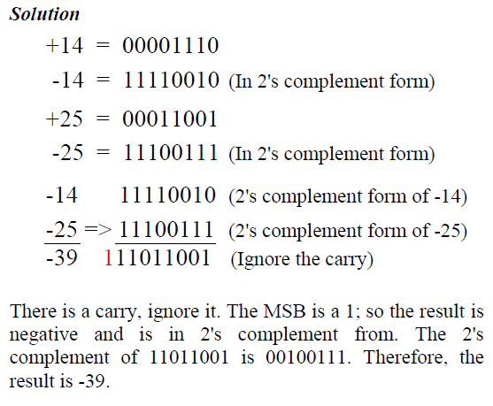
Example-3: Add -14 to -25 using 2’s complement method.

Slide 37
Problems:
Subtract 101011₂ from 111001₂ using 1’s complement and 2’s complement methods.
Carry out the following additions:
(i) (+13, -11) using 1‘s complement notation.
(ii) (-15, +9) using 2‘s complement notation.

Slide 38
Solutions:
(i) 111001 = 00111001
101011 = 00101011
1’s complement of 00101011 = 11010100
00111001
11010100
100001101
1 (End around carry)
00001110
(ii)111001 = 00111001
101011 = 00101011
2’s complement of 00101011 = 11010101
00111001
11010101
100001110
(Discard the carry)
00001110

Slide 39
(i) +13 = 0000 1101
+11 = 0000 1011
-11 = 1111 0100 (1’s complement form)
0000 1101
1111 0100
10000 0001
1 (End around carry)
0000 0010
The MSB is a 0. So, the result is positive and is in pure binary. Therefore, the result is 0000 0010 = +2
(ii) +15 = 0000 1111
-15 = 1111 0001 (2’s complement form)
+9 = 0000 1001
1111 0001
0000 1001
1111 1010
There is no carry, the MSB is a 1. So, the result is negative and is in 2’s complement form. The magnitude is 2’s complement of 1111 1010, i.e. 0000 0110 = 6. Therefore, the result is -6.

Slide 40
Floating-Point Number Representation

Slide 41

Floating-Point is useful for representing a number in a wide range: very small to very large.
It is widely used in the scientific world.

Slide 42
There are many ways to write a number in scientific notation, but there is always a unique normalized representation, with exactly one non-zero digit to the left of the point.
Example:
257 = 25.7 × 10¹ = 2.57 × 10² = …
0.232 × 10³ = 2.32 × 10² = 23.2 × 10¹ = …
01001 = 1.001 × 2³ = ...

Slide 43
What’s the normalized representation of 00101101.101 ?
00101101.101 = 1.01101101 × 2⁵
What’s the normalized representation of 0.0001101001110 ?
0.0001101001110 = 1.101001110 × 2⁻⁴

Slide 44
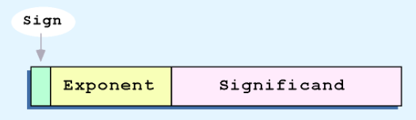
We can represent floating-point numbers with three binary fields:
  a sign bit S,
  an exponent field E, and
  A significand (mantissa) / fraction field F.

Slide 45
The IEEE 754 standard defines several different precisions.
  Single precision (32 bits) [1 + 8 + 23]
  Double precision (64 bits) [1 + 11 + 52]
  Extended precision (80 bits) [1 + 15 + 64]

Slide 46
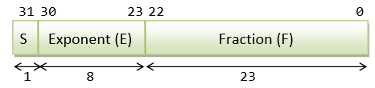
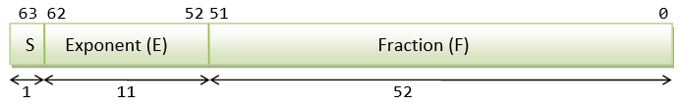
Single precision numbers include a 1-bit sign, an 8-bit exponent and a 23-bit fraction, for a total of 32 bits.
Double precision numbers have a 1-bit sign, an 11-bit exponent and a 52-bit fraction, for a total of 64 bits.

Slide 47

The sign bit is
0 for positive numbers and
1 for negative numbers.

Slide 48

The E field represents the exponent as a biased number.
It contains the actual exponent plus 127 for single precision, or the actual exponent plus 1023 in double precision.
This converts all single-precision exponents from -126 to +127 into unsigned numbers from 1 to 254, and all double-precision exponents from -1022 to +1023 into unsigned numbers from 1 to 2046.

Slide 49

The field F contains a binary fraction.
The actual mantissa of the floating-point value is (1 + F).
  In other words, there is an implicit 1 to the left of the binary point.
  For example, if F is 01101..., the mantissa would be 1.01101...

Slide 50
Example: What is the single-precision representation of 347.625?
First convert the number to binary:
347.625 = 101011011.101₂
Normalize the number by shifting the binary point until there is a single 1 to the left:
101011011.101 × 2⁰ = 1.01011011101 × 2⁸
The bits to the right of the binary point comprise the fraction field F.
The number of times you shifted gives the exponent.
The field E should contain:
exponent + 127 = 8 + 127 = 135 = 10000111₂
Sign bit: 0 if positive, 1 if negative.
0 10000111 01011011101000000000000

Slide 51
Example: Find out the floating point number from the following representation.
0 10000011 00111000000000000000000
0 10000011 00111000000000000000000
E = 10000011₂ = 131
N = (-1)^{S} × (1 + F) × 2^{E-bias}
= (-1)⁰ × (1.00111000000000000000000) × 2¹³¹⁻¹²⁷
= 1 × (1.00111000000000000000000) × 2⁴
= 1.00111000000000000000000 × 2⁴
= 10011.10
= 19.5

Slide 52
Example: Express -3.75 as a floating point number using IEEE single precision.
First, let's normalize according to IEEE rules:
- 3.75 = - 11.11₂ = - 1.111 × 2¹
Since it is a negative number , so S = 1.
The bias is 127, so we add 127 + 1 = 128 (this is our exponent)
E = 128 = 10000000₂
1 10000000 11100000000000000000000

Slide 53
Example: Find out the floating point number from the following representation.
1 1000 0001 011 0000 0000 0000 0000 0000
1 1000 0001 011 0000 0000 0000 0000 0000
E = 10000001₂ = 129
N = (-1)^{S} × (1 + F) × 2^{E-bias}
= (-1)¹ × (1.01100000000000000000000) × 2¹²⁹⁻¹²⁷
= - 1 × (1.01100000000000000000000) × 2²
= - 1.01100000000000000000000 × 2²
= - 101.10
= - 5.5

